Slide 1
Navigating Commissioner Tools for the Administrative Commissioner

Slide 2
Overview
Current version of Commissioner Tools debuted February 2025
District and Unit dashboards are fully functional
Next major update will be 1st Quarter 2026 with rollout of Council Commissioner dashboard
Focus is on “information at a glance”
Links enable you to drive down to more detailed information
Blue is a link (must click on)
Grey is information (hover cursor)
In several tabs, links take user directly to other My.Scouting.org functions (Roster, Application Manager, Organization Manager, etc…) within the same access level

Slide 3
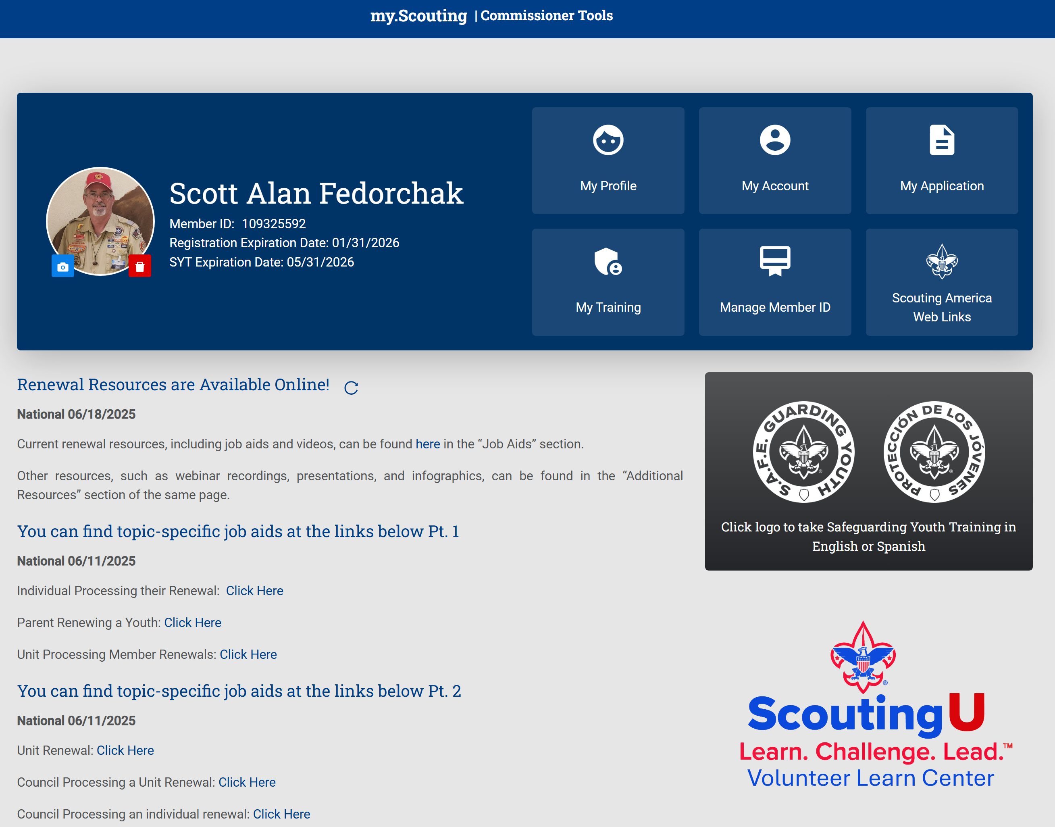
My.Scouting.org Home Page
What’s new?
Profile Photo
Member Renewal
Unit Renewal

Slide 4
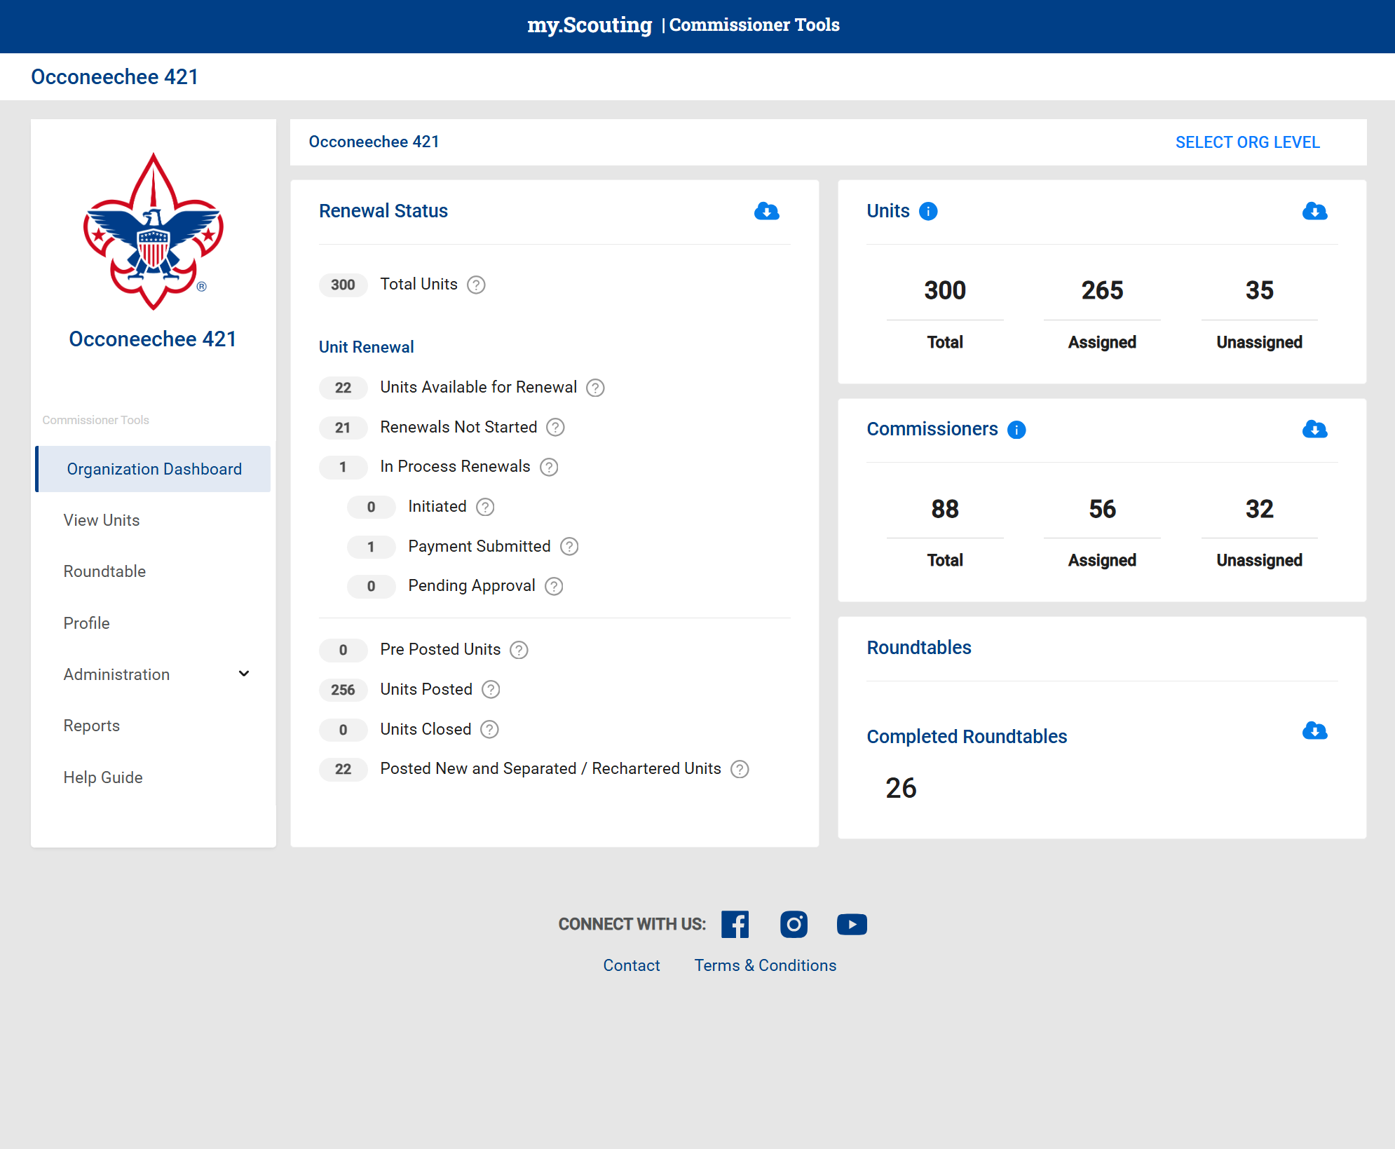



Commissioner Tools Home Page (Council)
Current information on CC page is sparse
Link generate reports
Link generates additional information
Pop-up information screen
Most useful tabs are:
Administration
Reports
Several tabs currently not functional
Dedicated CC page due 1st Quarter 2026

Slide 5
Commissioner Tools Home Page (Council)
Units
Council Unit Roster with
assigned or unassigned
Commissioner as .csv or .pdf
Information description
Commissioners
Council Commissioner
Roster with assigned or
unassigned Commissioner
as .csv or .pdf
Commissioners are counted
once regardless of
registrations
Information description
Renewal status
Generates Council renewal
report as .csv or .pdf
Tracks unit renewal status
through the process
Information description
All reports also available on drop down menu on Organization Dashboard

Slide 6
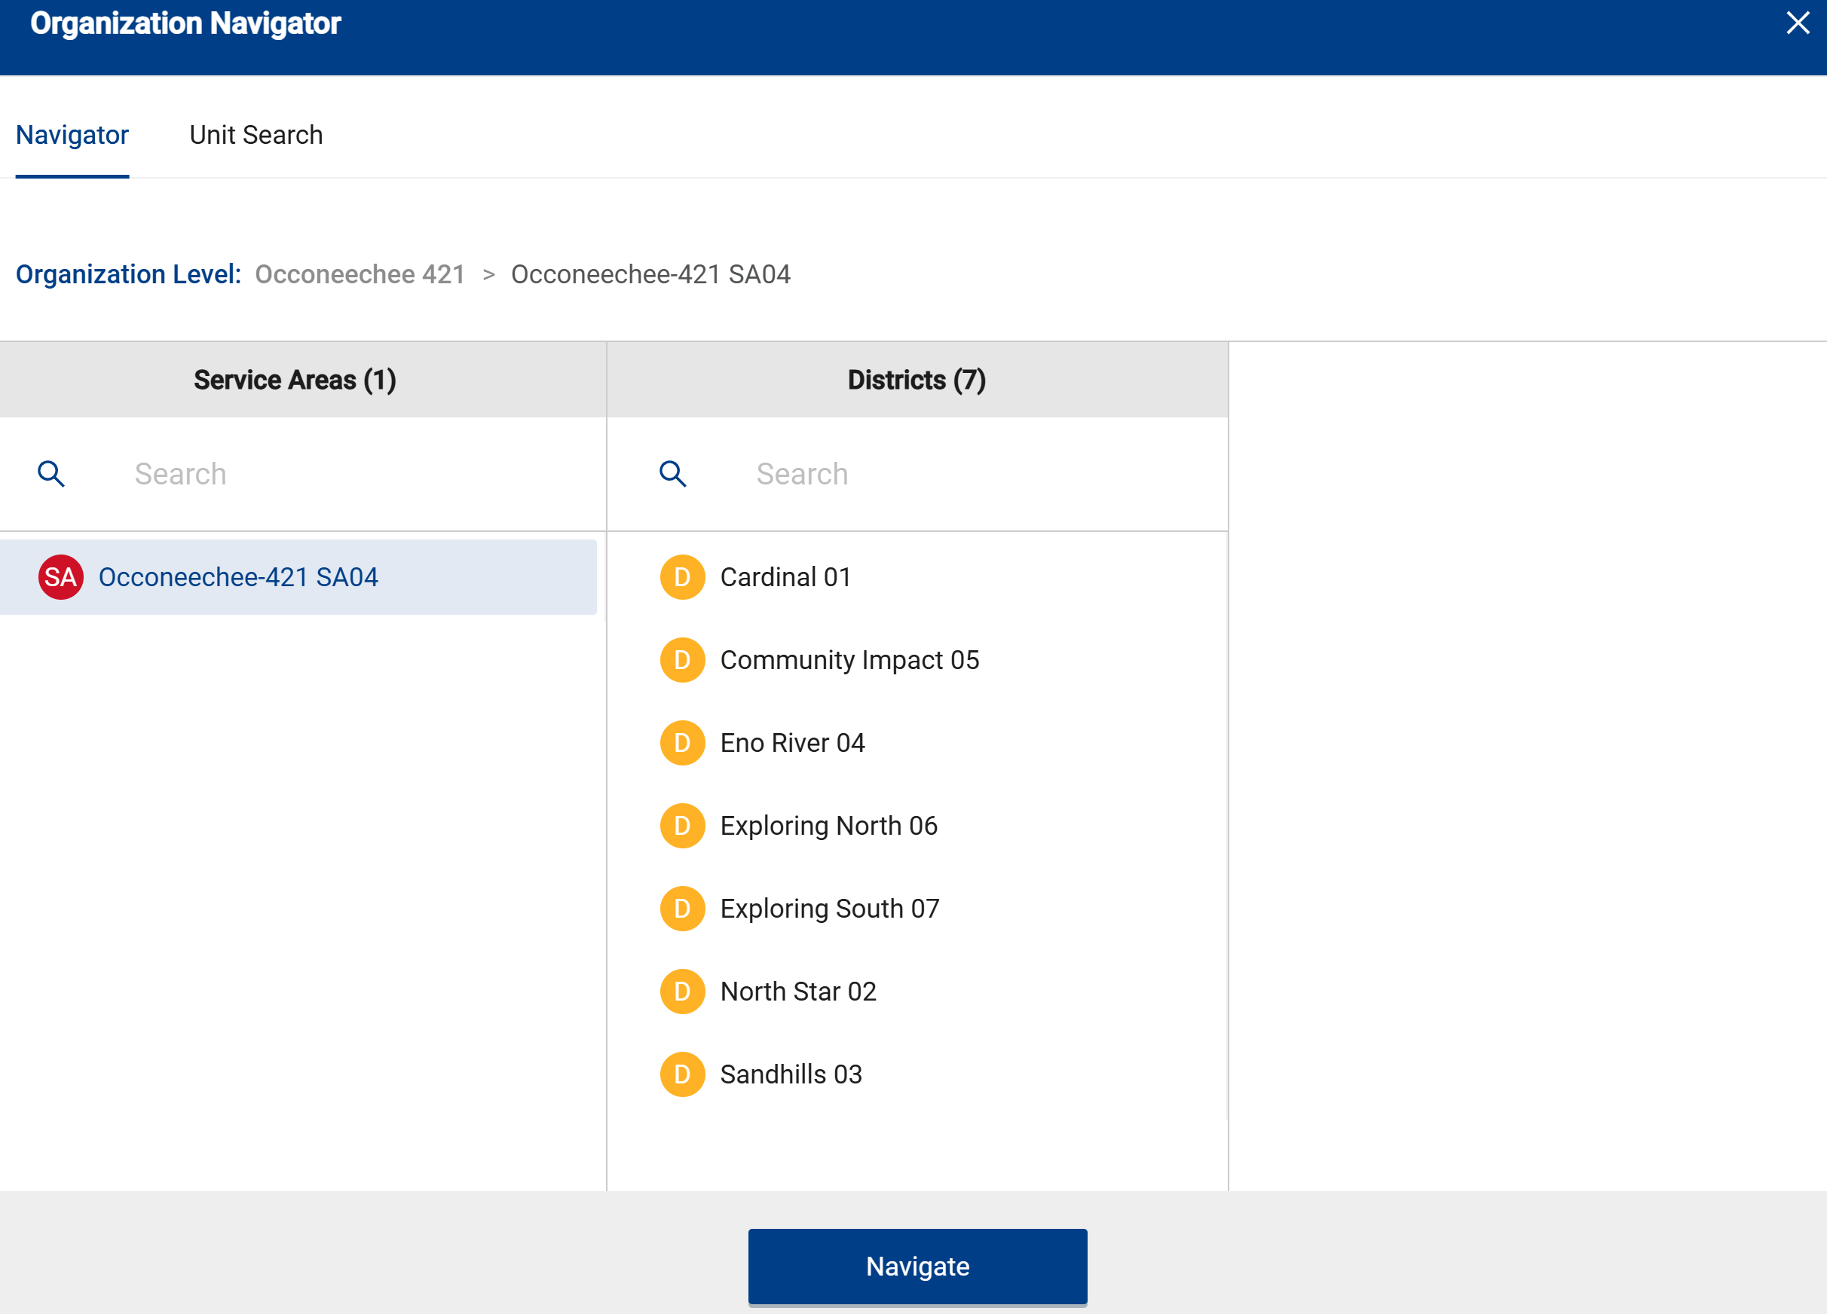
Commissioner Tools Home Page (Council)
If you want to look at a specific unit, there are usually two ways to access data
Select Unit
View Unit does not work on
Council dashboard

Slide 7
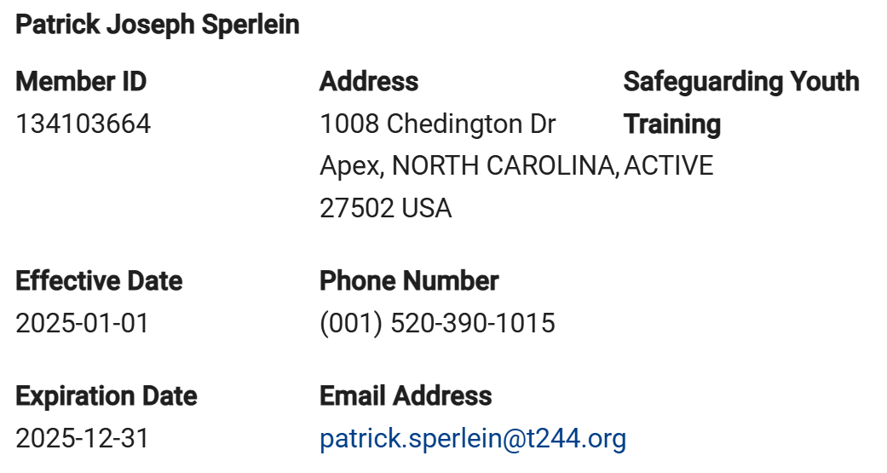
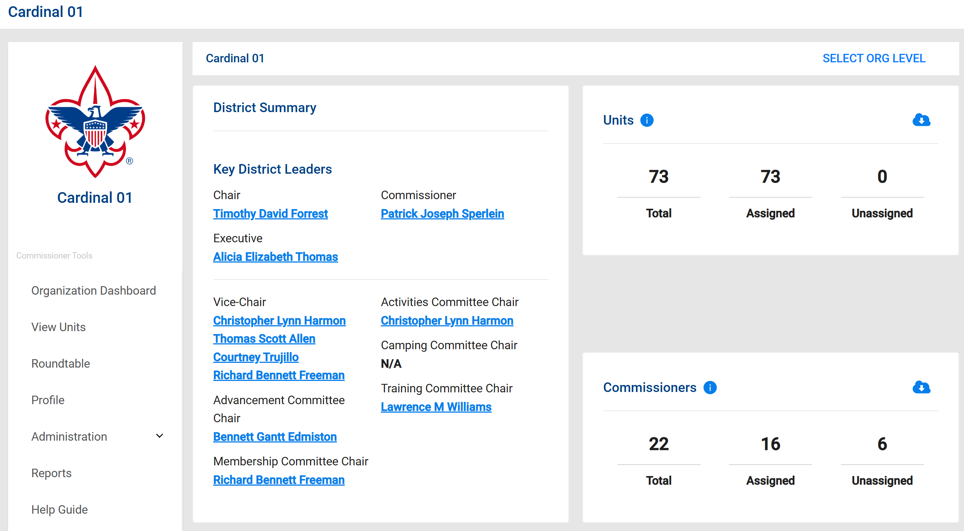
Commissioner Tools Home Page (District)
District page has actionable information
All drop down menus are live
More detailed information than CC page; but Renewal status is now a tab at screen bottom
District Summary
Link generates contact information
Most useful tabs are:
Administration
Reports
Notes:
This is a view of a district dashboard. It will open after entering Commissioner Tools and selecting Organization Dashboard. This will be the first step whether using the web or mobile versions. At the top you will see a list of key district leaders. Notice their names are all in blue. The names are hyper links that provide contact information for each person. The top right section shows the number of units in the district and how many have a commissioner assigned. The Commissioner section shows how many commissioners are registered in the district and how many are assigned to a unit(s).

Slide 8
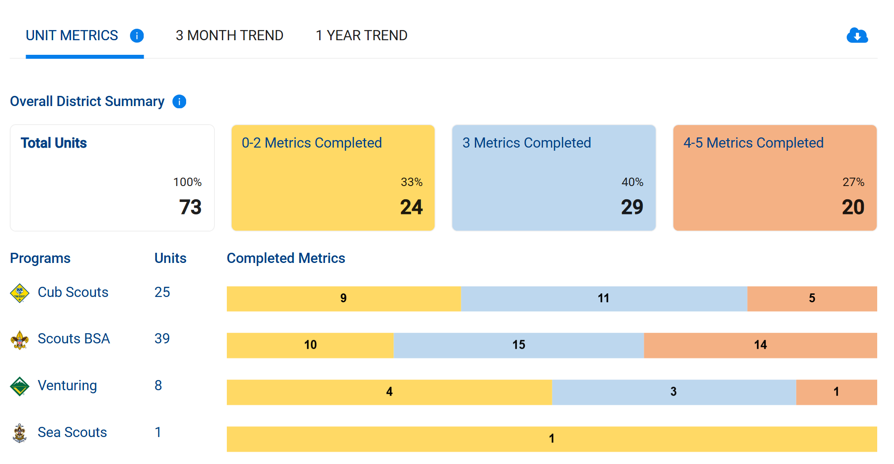
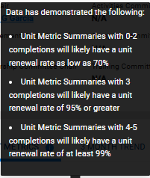
Commissioner Tools Home Page (District)
District Metrics completed summary by program
Color schemes deliberately chosen to avoid perception of grading
Notes:
This section displays a summary of the unit metrics across the district and how many units have met each threshold. It can be viewed for the current state, or by toggling the 3 month and 1 year trends for identifying how that data has changed over time. Below that is a breakdown of each program by the level of completed metrics.
To understand what each of the metrics are and what the thresholds are, click on the blue icon by the Unit Metrics title. To understand the significance of how the metrics can be used for helping units, click on the blue icon by the Overall District Summary title. In each case, a pop-up message will appear.
When clicking on the Show Details at the bottom of this slide, more information is available as shown on the next slide.

Slide 9
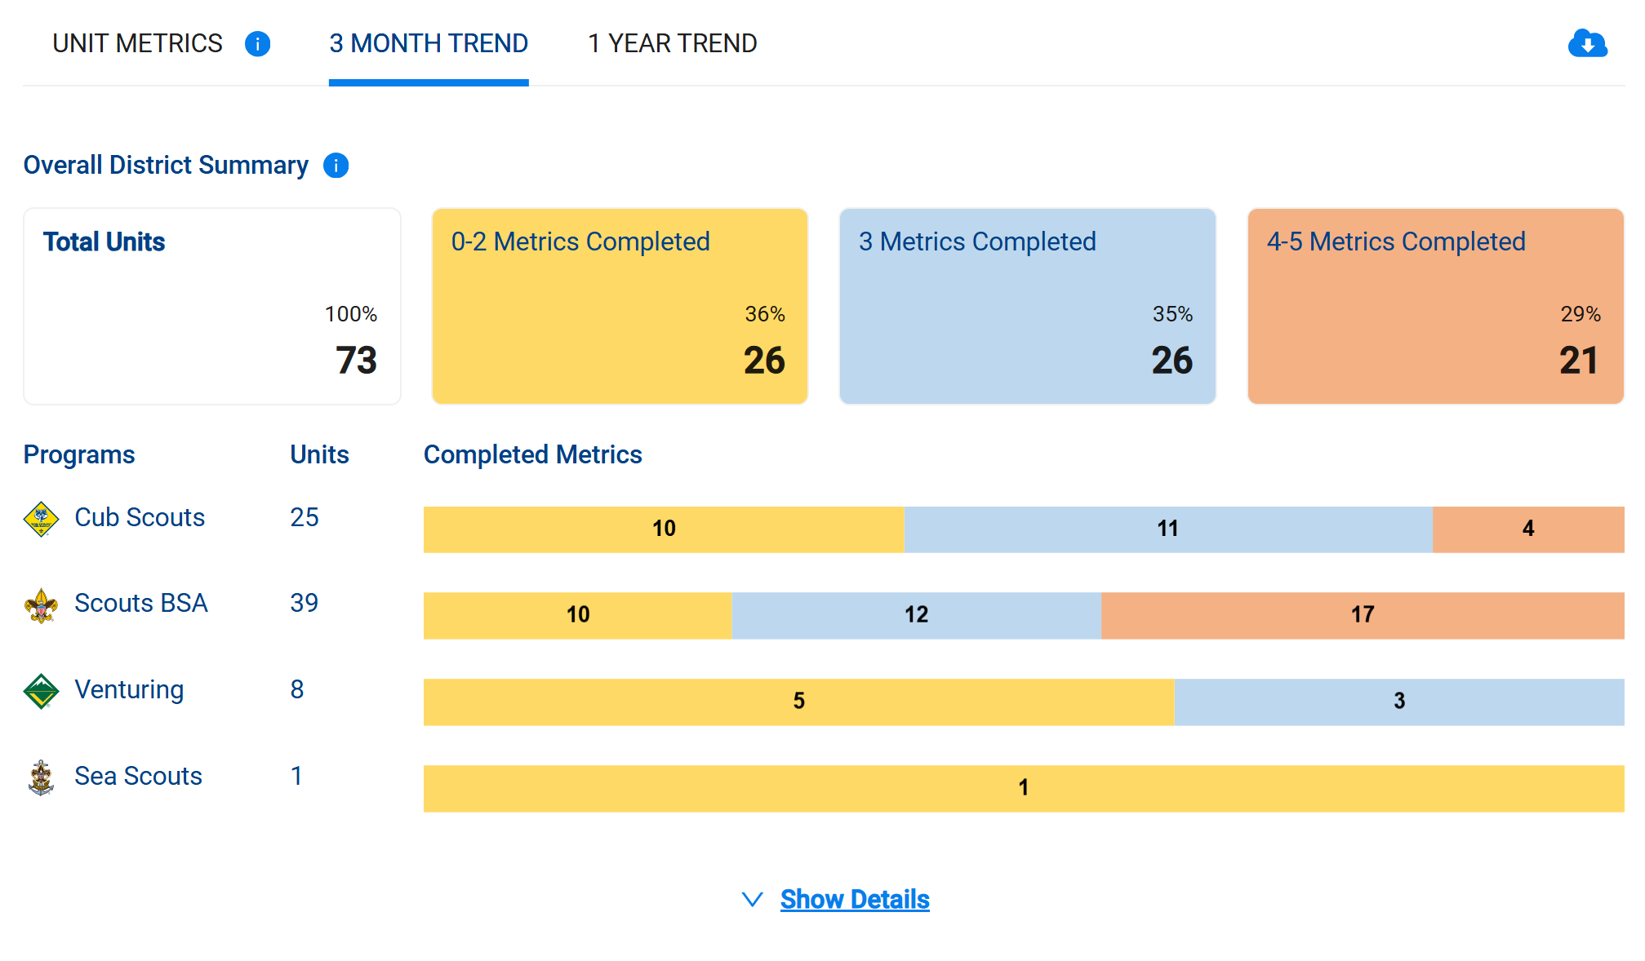
Commissioner Tools Home Page (District)
What’s new?
3 Month Trend
Shows District status three (3) months ago
1 Year Trend will be available Feb 26
Notes:
This section displays a summary of the unit metrics across the district and how many units have met each threshold. It can be viewed for the current state, or by toggling the 3 month and 1 year trends for identifying how that data has changed over time. Below that is a breakdown of each program by the level of completed metrics.
To understand what each of the metrics are and what the thresholds are, click on the blue icon by the Unit Metrics title. To understand the significance of how the metrics can be used for helping units, click on the blue icon by the Overall District Summary title. In each case, a pop-up message will appear.
When clicking on the Show Details at the bottom of this slide, more information is available as shown on the next slide.

Slide 10
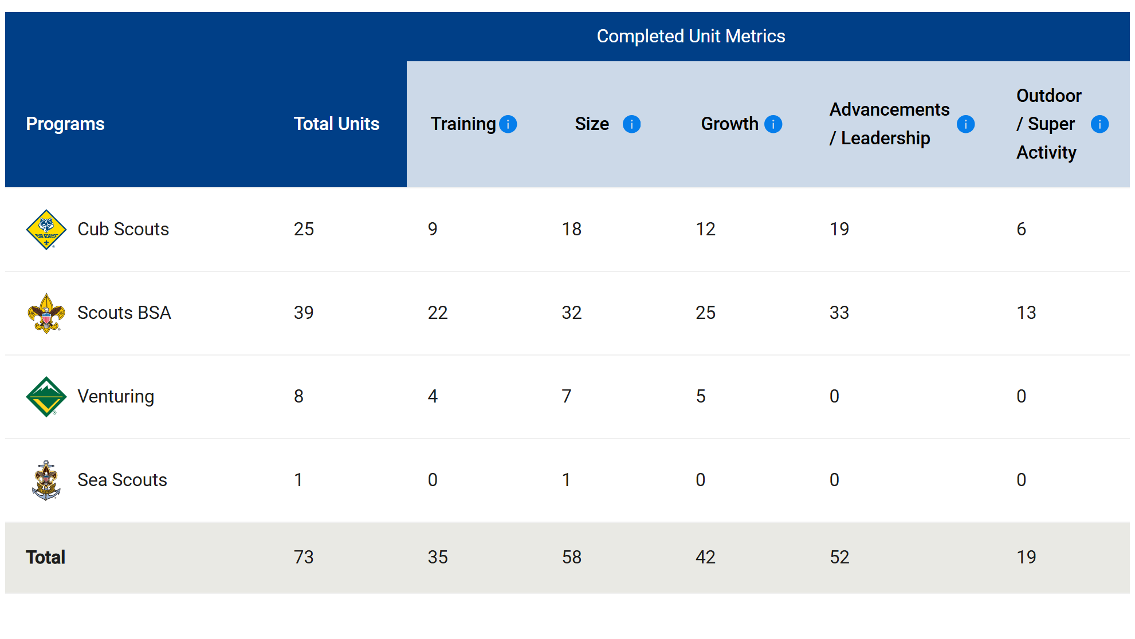
Commissioner Tools Home Page (District)
District metric summary by program
Metrics updated automatically for:
Training
Size
Growth
Advancements
Units must enter data separately for:
Outdoor / Super Activity
Senior Program Leadership
Shows metric requirement for completion
Notes:
This page shows a breakdown of each metric by the individual Scouting America programs. This is a useful chart to identify trends across programs and by metric. District Committees can use this information to apply help among different groups or topics where needed.

Slide 11
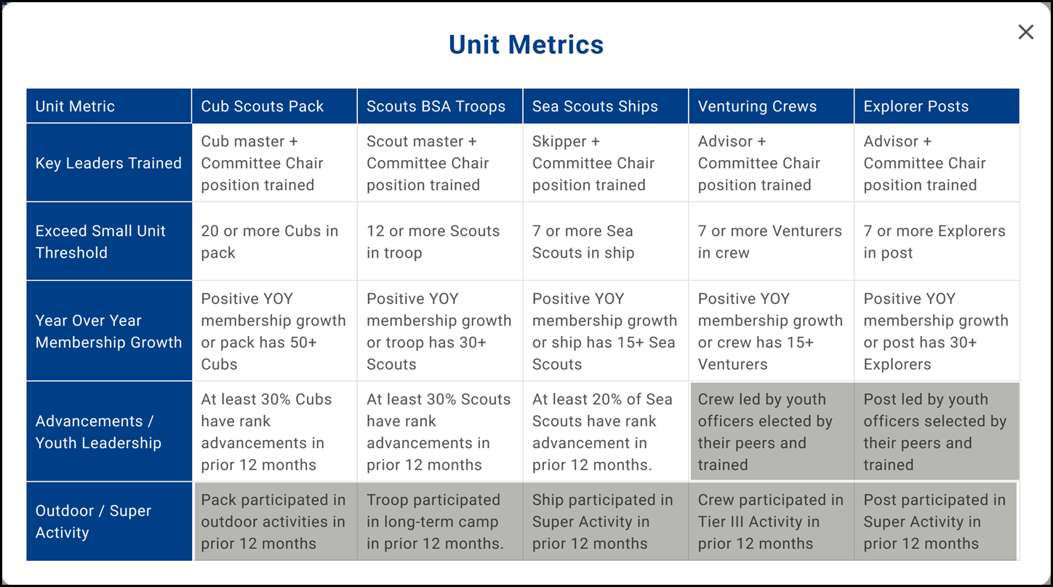
Unit Metrics
What’s coming up?
Currently five (5) metrics:
Grey shading indicates unit Key 3 entered metric
Youth Leadership entered in Organization Manager
Outdoor / Super activity entered in Organization Manager
Units using third party Unit Management Systems must use My.Scouting.org to enter this data
Sixth metric Retention will be available in 2026

Slide 12
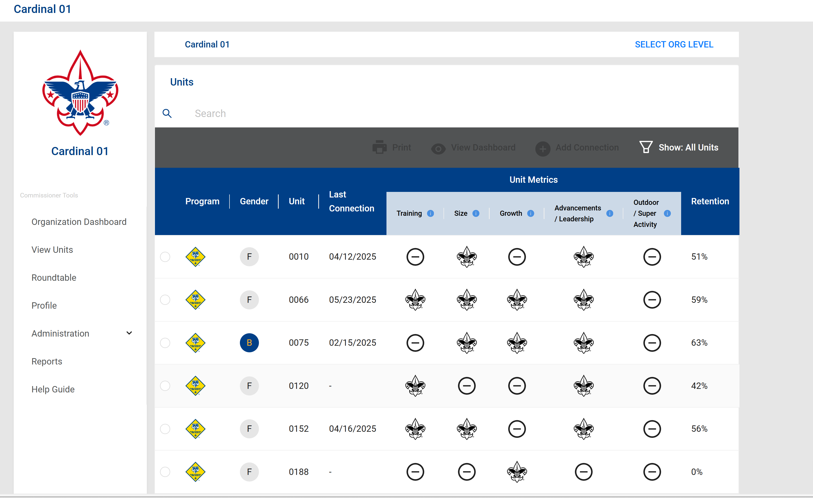

Commissioner Tools Home Page (District)
Unit summary by metric
Use the dropdown menu to View Units on home page
Metric met
Metric not met

Slide 13
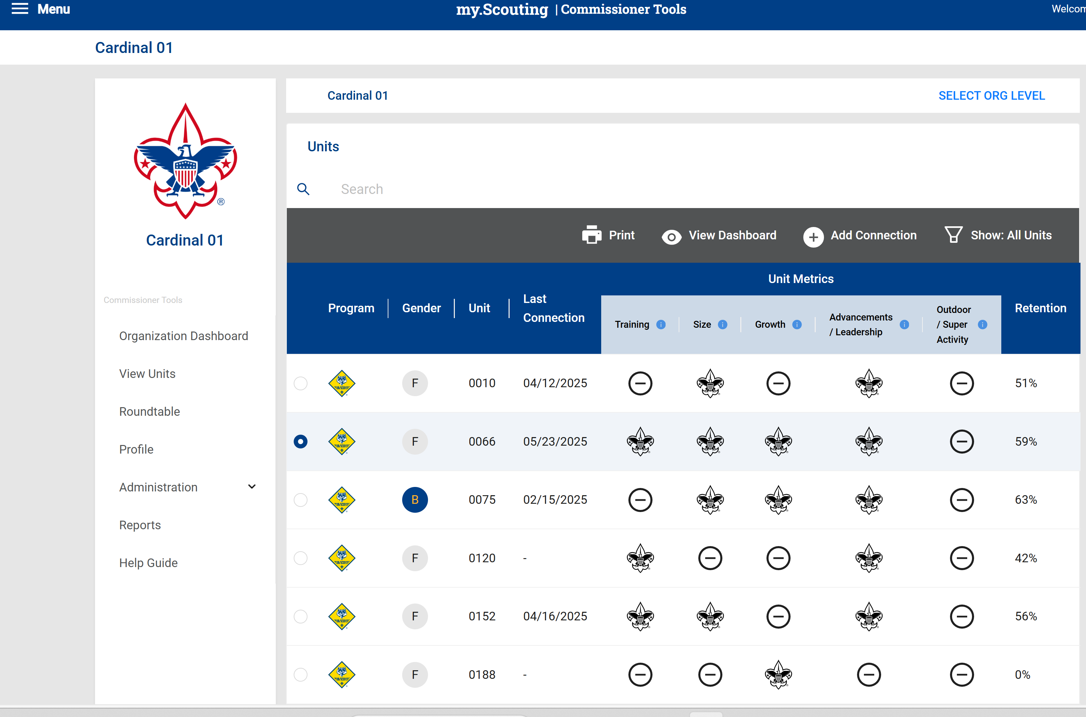
Commissioner Tools Home Page (District)
To access individual unit dashboard, select unit
Shows metric requirement for completion

Slide 14
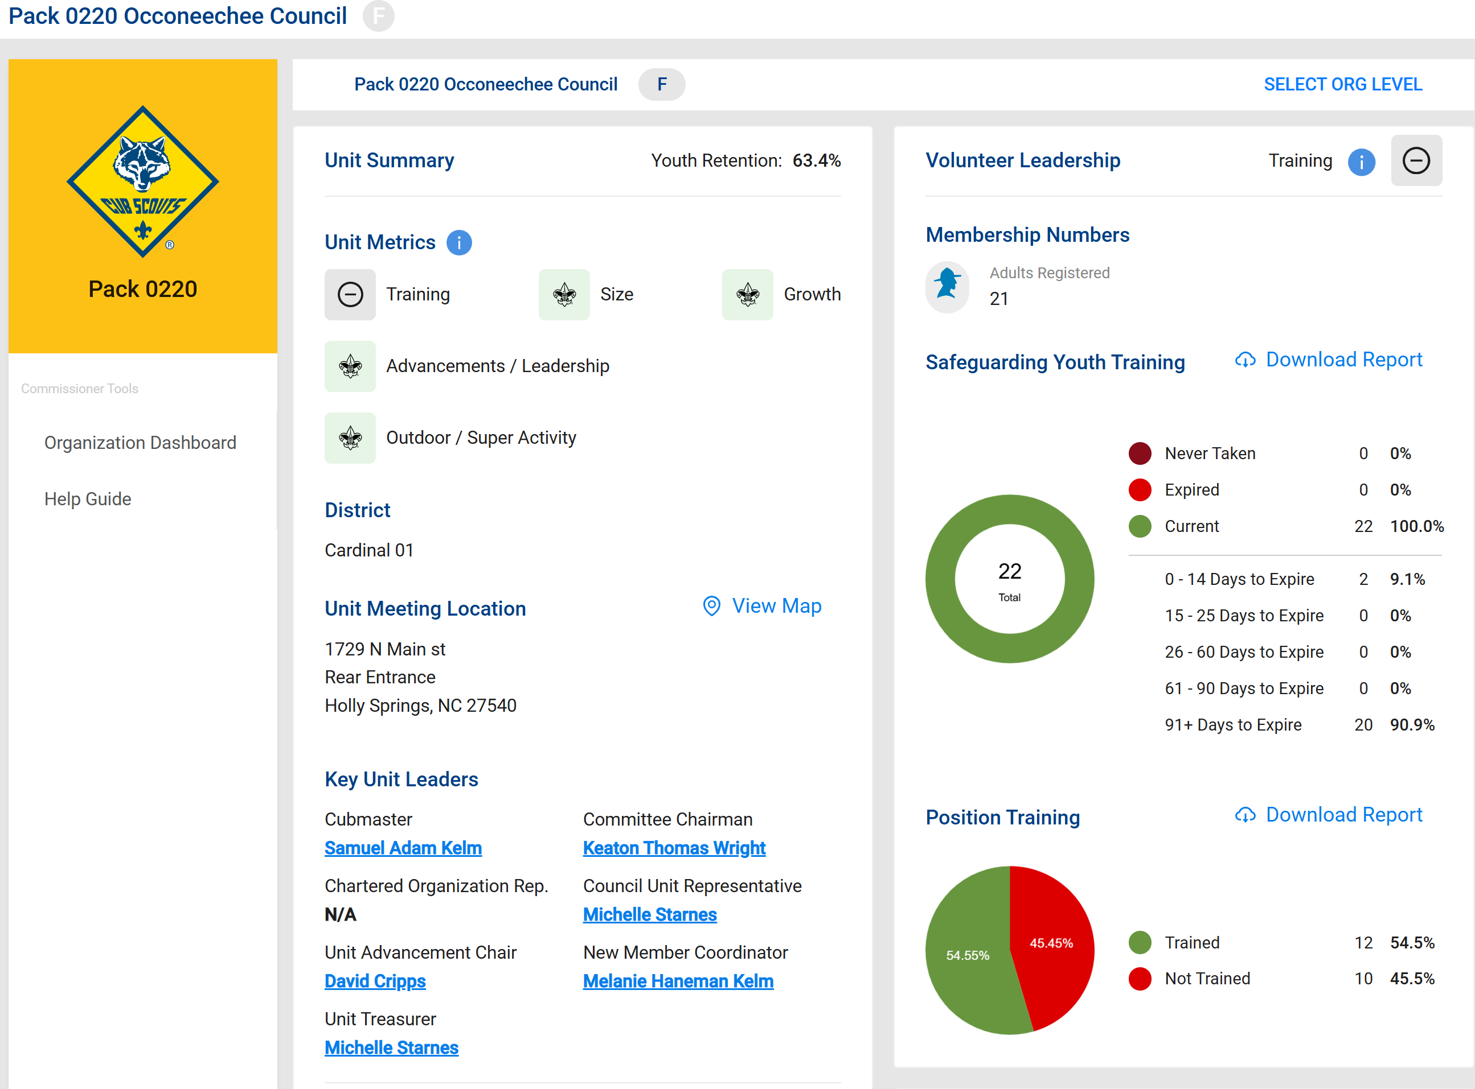
Commissioner Tools Home Page (Unit)
The unit dashboard has same
look at the District dash, but
more detailed information
Unit metrics are displayed
Shows metric table
Unit Meeting Location
Data mirrors unit pin
Default address is Charter Organization
Confirm meeting location!
Coming soon: Meeting date and time

Slide 15
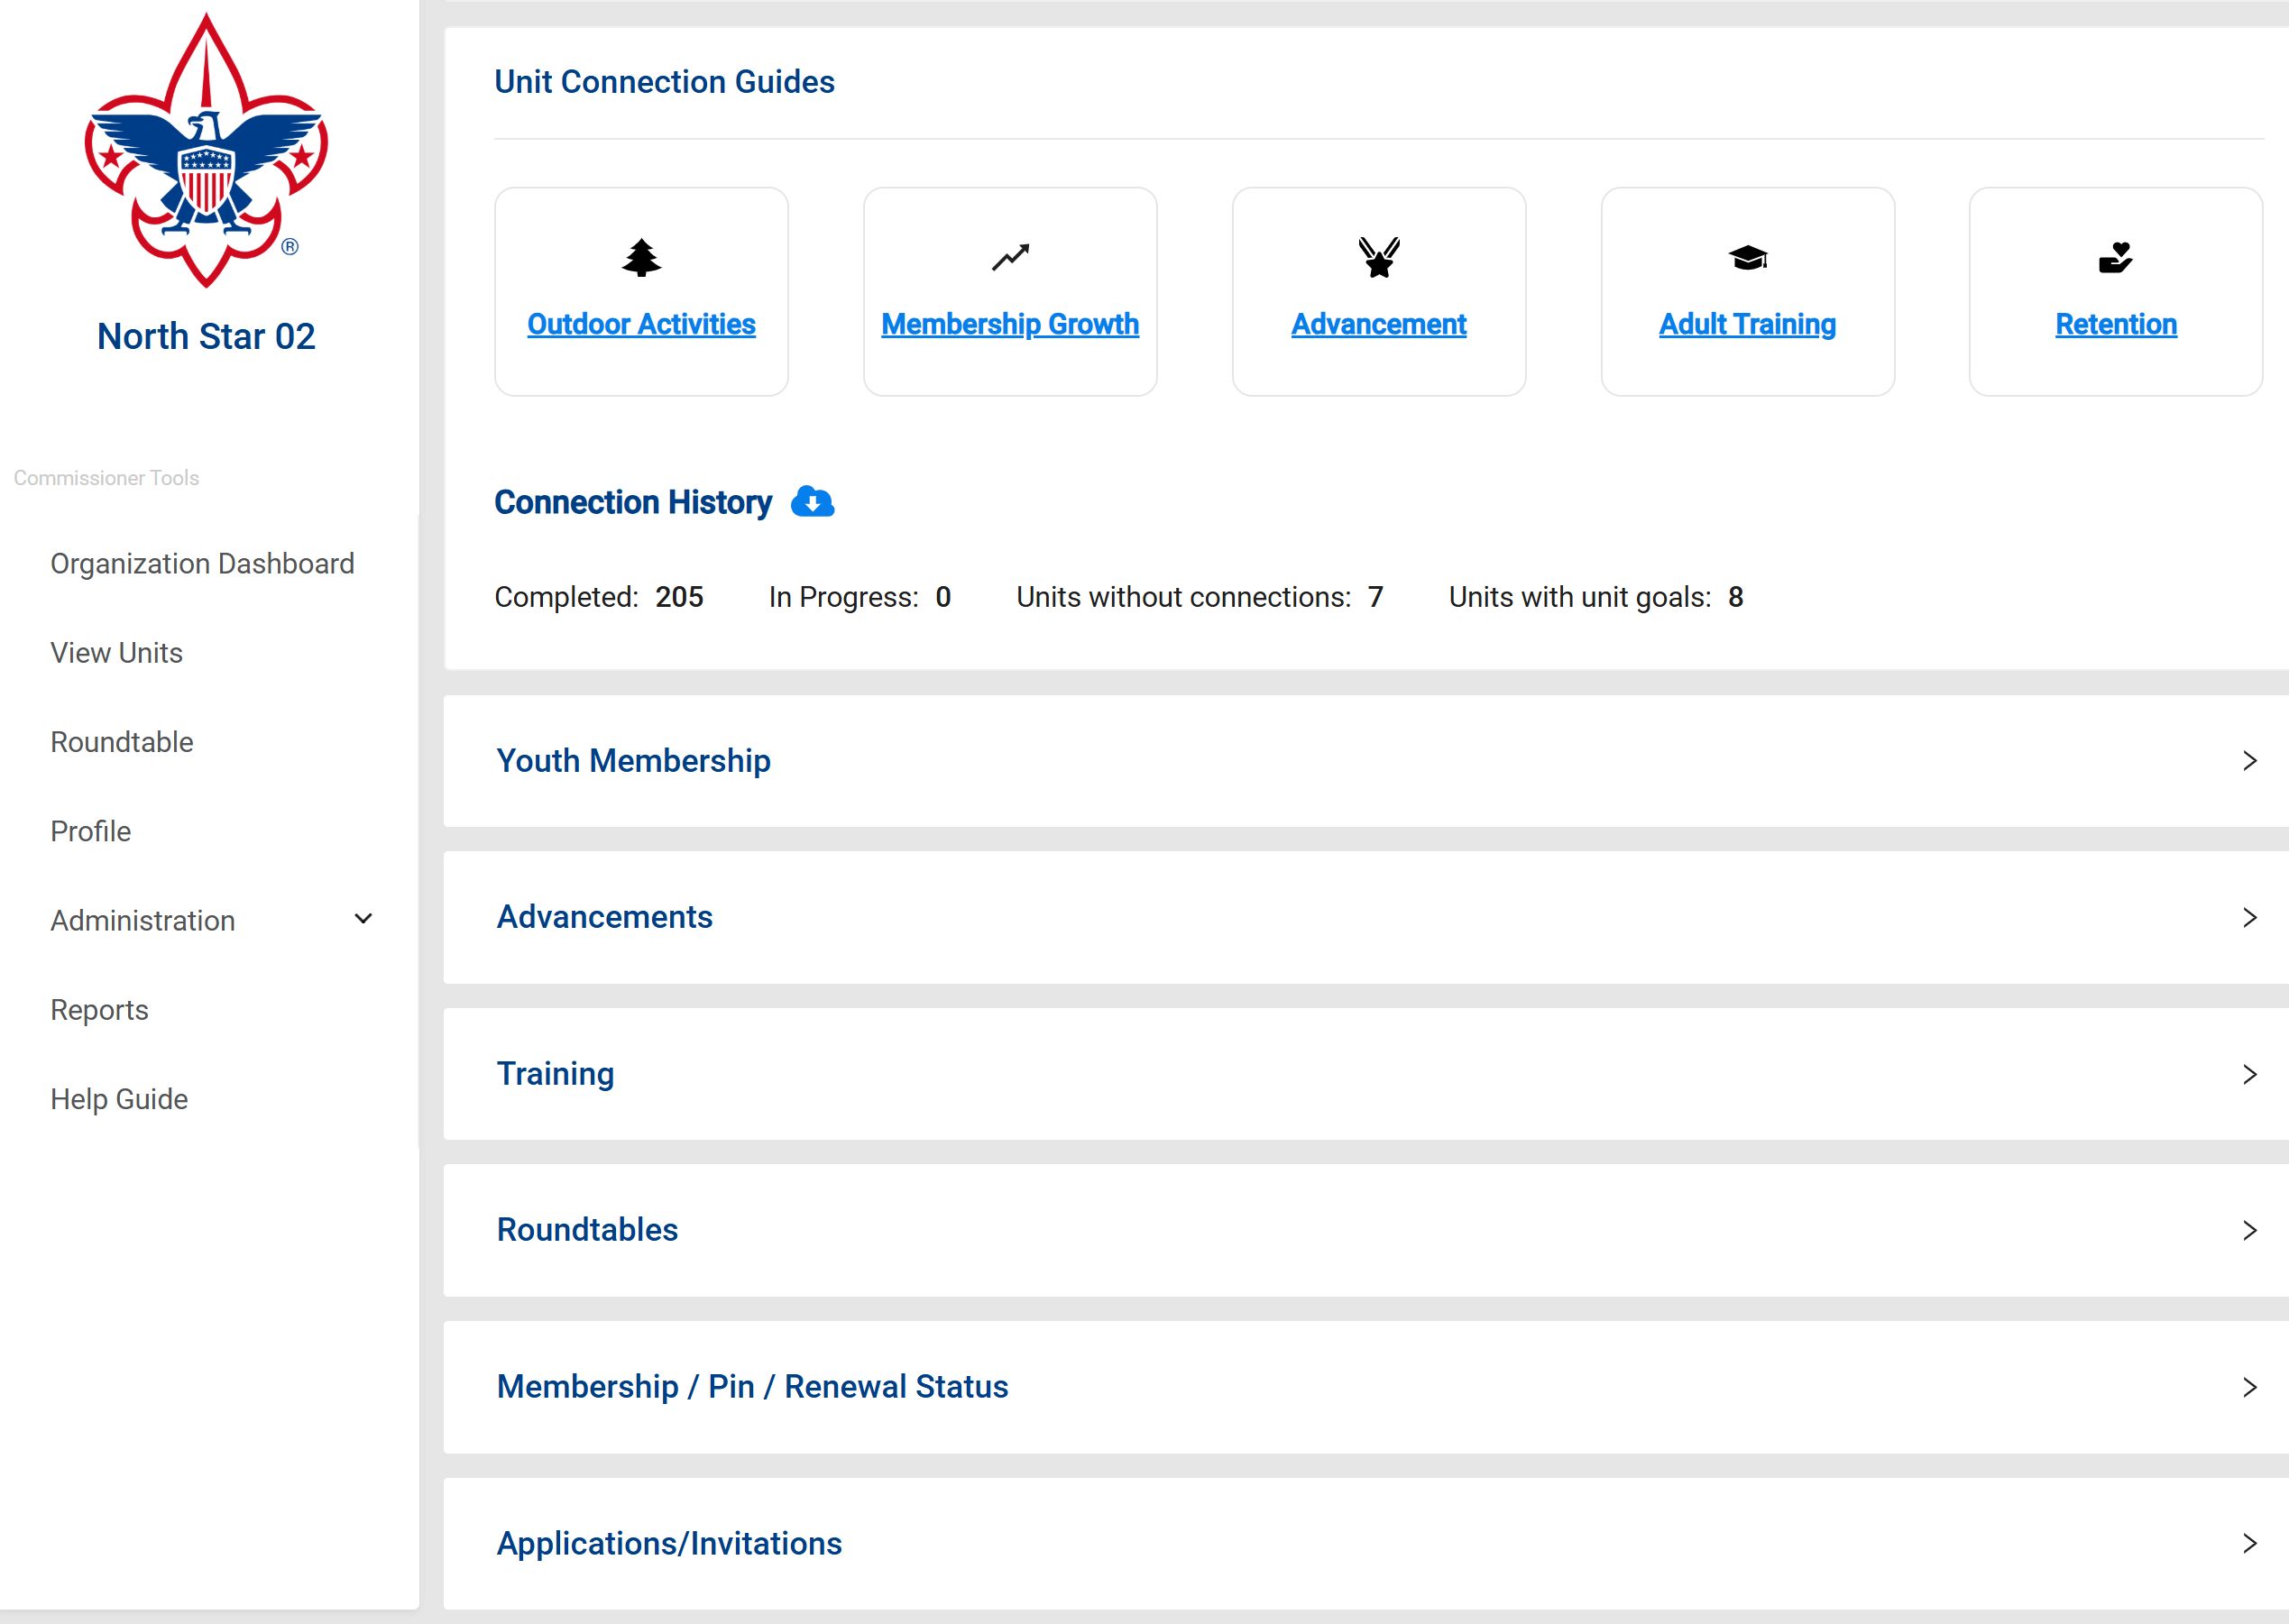

Other Data at a Glance
Generates by unit connection report (.csv)
This report is also available in drop down menu under Reports
Focus is Units without connections and Units with Goals
Symbol enables drop down screen

Slide 16
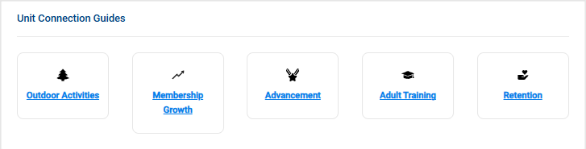
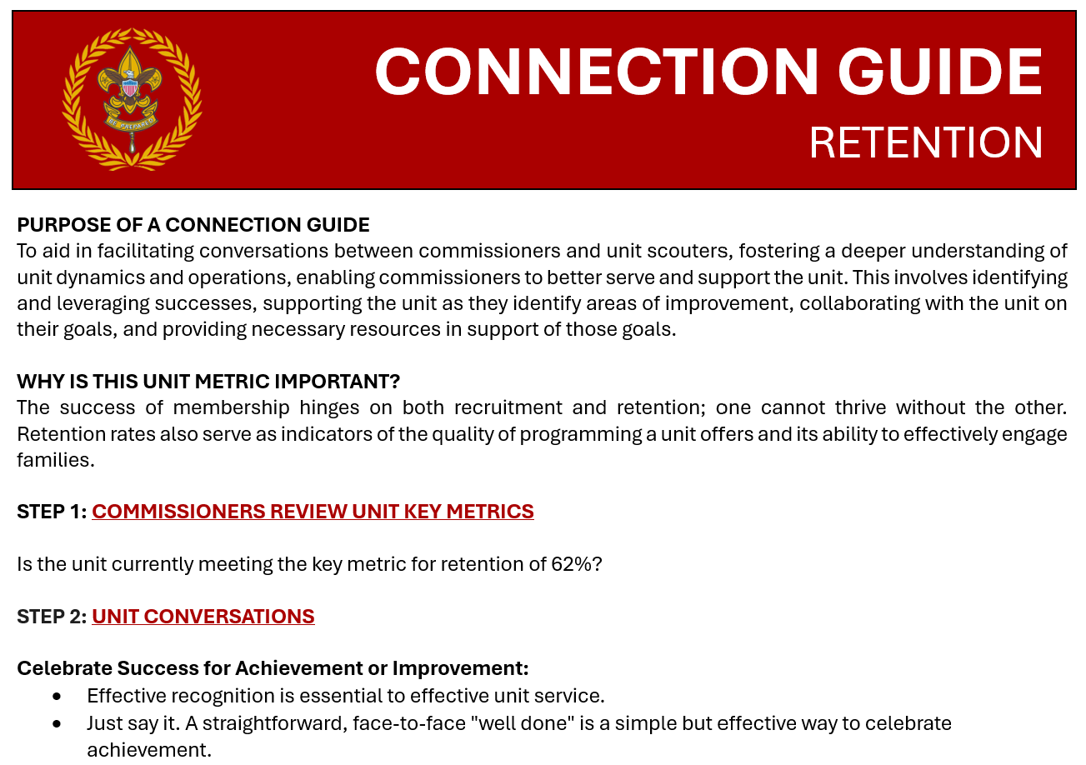
Connection Guides
Currently five (5) Unit Connection Guides
Additional Unit Connection Guides will be released in 2026
Notes:
Immediately below the metric summary data are Unit Connection Guides. Details of Unit Connection Guides are covered in another training module, but these are individual guides, by topics as noted, can assist a commissioner for how to have a meaningful and helpful discussion with unit leaders.

Slide 17
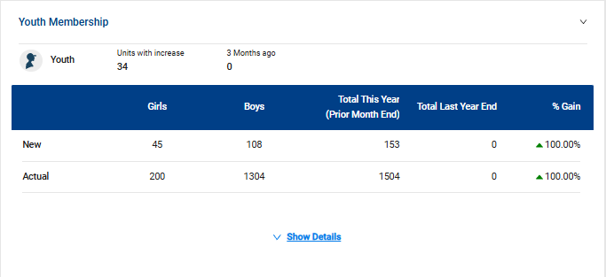
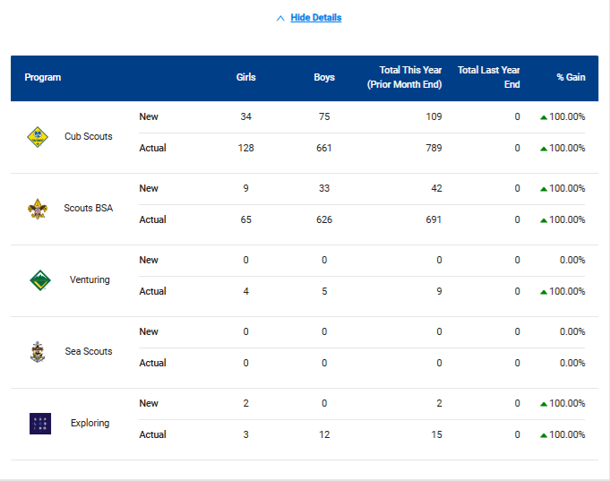
Youth Membership
Show details gives youth membership breakdown by program
More detailed breakdown of membership data may be found in Council Membership Tools in My.Scouting.org
Notes:
The next several sections that follow the Unit Connection Guides provide summaries of each of the Unit Metrics. The first is Youth Membership and provides an overall snapshot of a district’s youth membership. More detail is available, showing membership by each program area, when clicking on the Show Details link. See the next slide for an example.

Slide 18
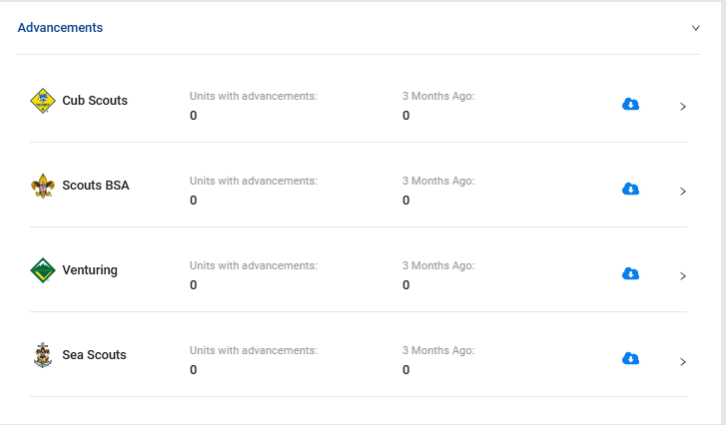
Advancements
Generates unit advancement reports that we used to have to request from Council Registrar or District Advancement Chairs
Data based on unit entry through Internet Advancement, Scoutbook+ or uploaded third party unit management systems (UMS) such as TroopMaster, PackMaster etc…
We are seeing issues with units using third party UMS and NOT uploading data
Notes:
Advancement data follows the Membership data. Expanding the Advancement section displays information by program shows trends of how the youth in the district are advancing. You can download detailed reports for each program by selecting the download report arrow.

Slide 19
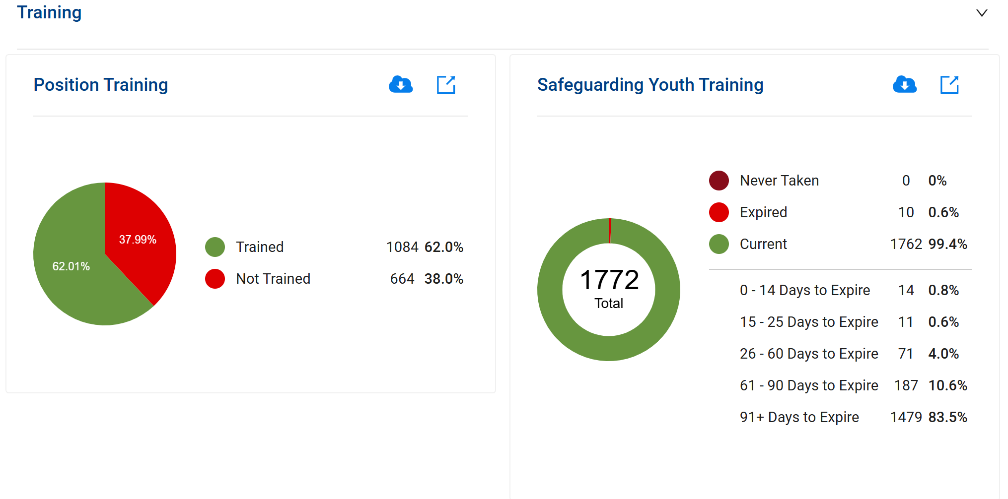

Training
Generates Training reports (.pdf and .csv)
Reports are also available through Training Manager in My.Scouting.org
Notes:
Further down the dashboard you see Volunteer Leadership. This section highlights how many total adults are registered followed by training information. At-a-glance, the District staff can note if units needs leaders to complete necessary training, particularly YPT. There is a quick synopsis of those members who have expired or soon to be expiring Youth Protection Training to aid in follow up. To view those details of what leaders are missing training, click on the Download Report. These two reports can be printed for use during an upcoming unit leader visit for helpful discussion.

Slide 20
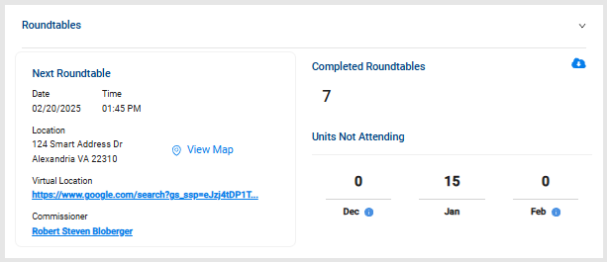
Roundtable
Generates report on unit attendance at District Roundtable (by number, not by name)
No current way to track individual attendance at District Roundtables (for Scouters seeking to complete Training Awards)
Focus here is on units NOT attending District Roundtables
Notes:
Further down the dashboard is the Roundtable information. At the top of this section is attendance over the past three months. If details are needed for that, click on the Download Report.
Knowing if units are participating in roundtable is important. If leaders are not attending roundtable, this would be an excellent conversation to have with the units who are not attending. By having at least one person attend a RT meeting each month, useful information can be brought back to the unit to help strengthen the unit’s program for their youth.
You’ll also note in this section when the Next RT meeting is, where it’s held, a single click to view a map of the location, a virtual meeting link if the district uses that option, and even who the RT commissioner is, which you can contact simply by clicking on their name for any necessary information.

Slide 21
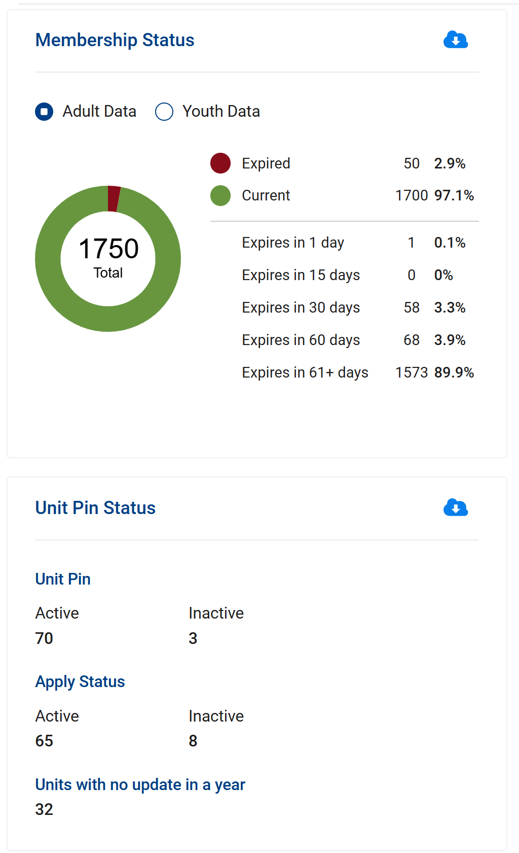
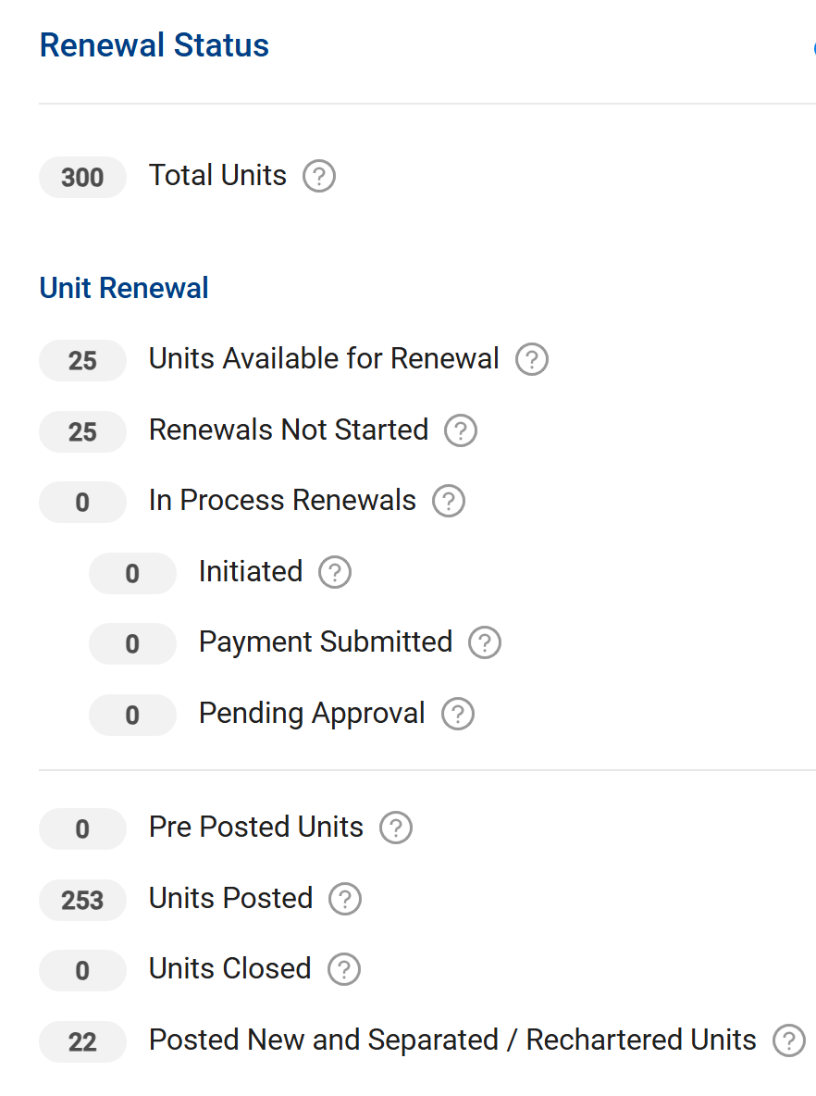
Membership Renewal
Membership report (.csv) showing current and expired adults and youth
Reports are also available through Roster in My.Scouting.org
Renewal status
Generates District renewal
report as .csv or .pdf
Tracks unit renewal status
through the process
Information description
Generates Unit Pin report (.pdf and .csv) showing current pin status and contact person
Notes:
Towards the bottom of the dashboard, is the Membership, Unit Pin, and Unit Renewal Status of units in the district. Toggle back and forth between adult and youth data to see the number of expired or soon to be expired members. The number of members with a current registration is also noted in the circle chart. Unit Renewal information is also summarized in this section. This section provides unit pin status along with the last update.

Slide 22
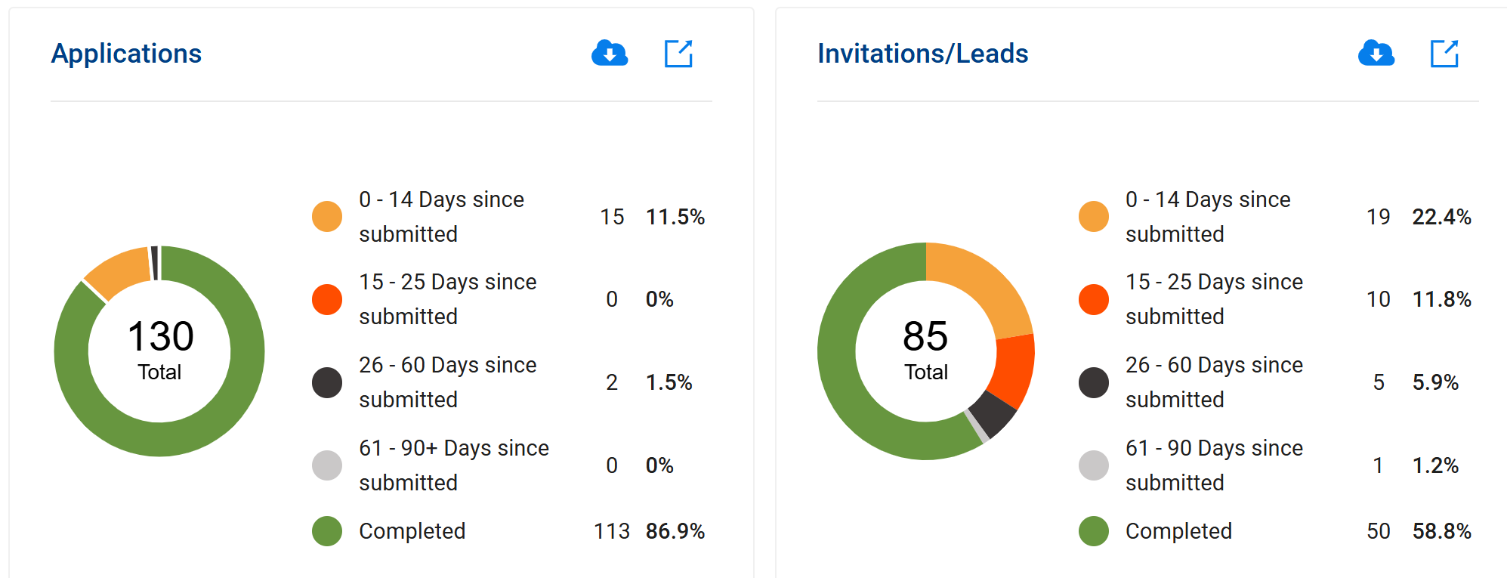
Applications/Invitations
Generates Training reports (.pdf and .csv)
Reports are also available through Application Manager and Invitation Manager in My.Scouting.org
Green and Gold is “good”; leads and applications are completed or followed up in a timely manner
Orange and Black is “not so good”; we are potentially losing these leads and applications
Notes:
The final section of the district dashboard shows the status of applications and invitations in the district. Detailed reports can be obtained by clicking on the download report arrow for each category. The boxed arrows in each of these two sections will direct you to the Application and Invitation Manager apps.

Slide 23
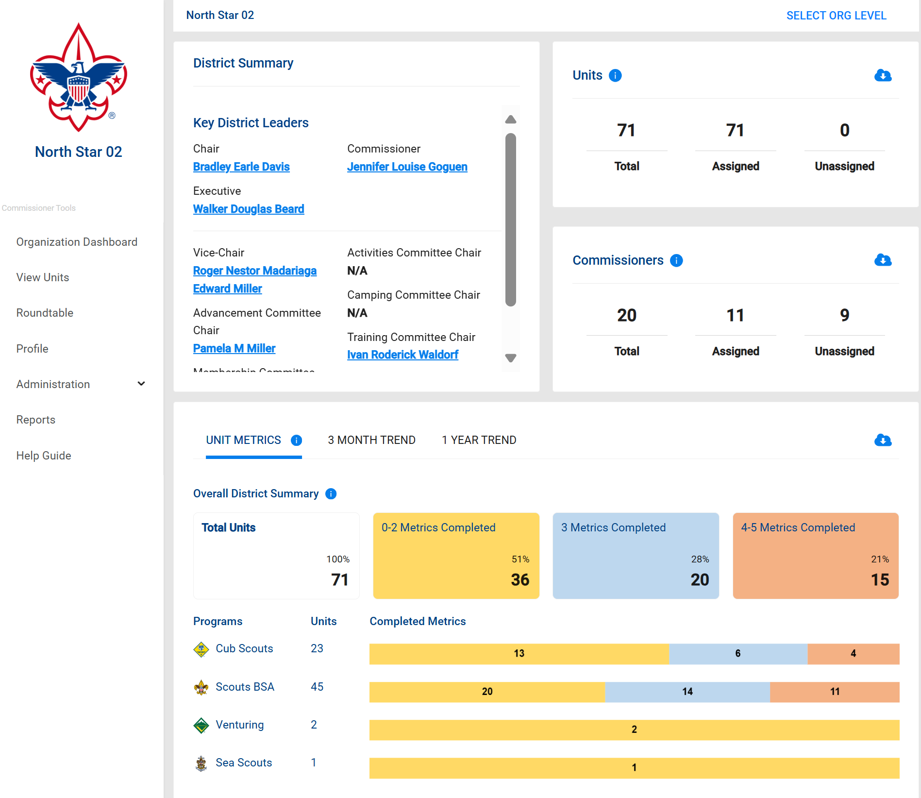
Commissioner Tools Reports
Drop down menu accessed through Reports tab
Most useful Administration reports are:
Simple Assessments with comments
Unit Connection History
Shows all connections by unit
Unit Metric Status Report
Shows metrics achieved
Commissioner contacts
Shows who is making connections
Commissioners without Contacts
Shows who is not making connections
Data available for last 3 years
Legacy Commissioner reporting data remain available until 2027:*
District Contact Status
Simple Assessments
Detailed Assessments
Service Plans
Priority Needs Units
* Must set date range to see the legacy data
There are no reports available on Unit Goals
Notes:
Commissioner Tools Reports
These are key Commissioner Tools reports that you can use to monitor unit service in your council:
Unit Connection History report shows the Unit Connections History for each unit.
Unit Metric Status Report shows the metrics achieved/completed for each unit.
District Contact Status report provides information on units with the number of connections made during the year, spread by month.
Priority Needs Units is a tool that identifies units within the district that require support. These units need help now. In a district that might have limited commissioner resources, you can use the information in this report to assign commissioners to the units with the greatest need for assistance.
Roundtable Attendance report shows roundtable attendance spread by month for units (excludes Posts and Clubs).
An assistant council commissioner can generate this information for you monthly so that you can keep district commissioners accountable for unit service in their districts.

Slide 24
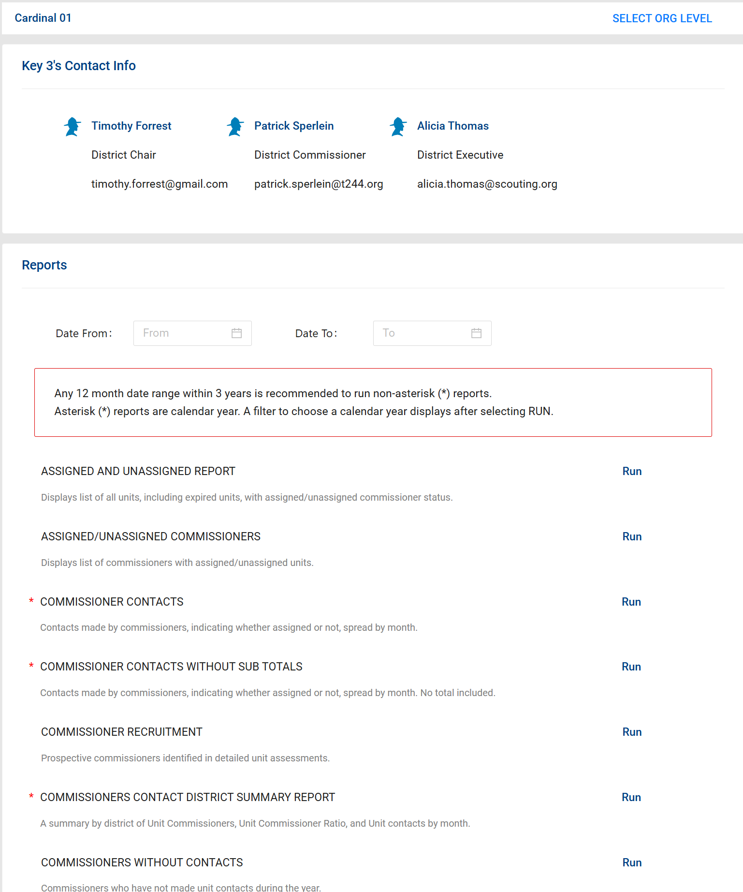
Commissioner Tools Reports
Default reporting period is YTD unless you specify Data From : Data To dates
Available reports are listed alphabetically
Reports can be exported as .pdf or .csv
.pdf useful for Council reporting data
.csv useful for analysis
Scroll down to desired report, click on Run*
* Must set date range before clicking on Run!
Notes:
Commissioner Tools Reports
These are key Commissioner Tools reports that you can use to monitor unit service in your council:
Unit Connection History report shows the Unit Connections History for each unit.
Unit Metric Status Report shows the metrics achieved/completed for each unit.
District Contact Status report provides information on units with the number of connections made during the year, spread by month.
Priority Needs Units is a tool that identifies units within the district that require support. These units need help now. In a district that might have limited commissioner resources, you can use the information in this report to assign commissioners to the units with the greatest need for assistance.
Roundtable Attendance report shows roundtable attendance spread by month for units (excludes Posts and Clubs).
An assistant council commissioner can generate this information for you monthly so that you can keep district commissioners accountable for unit service in their districts.

Slide 25
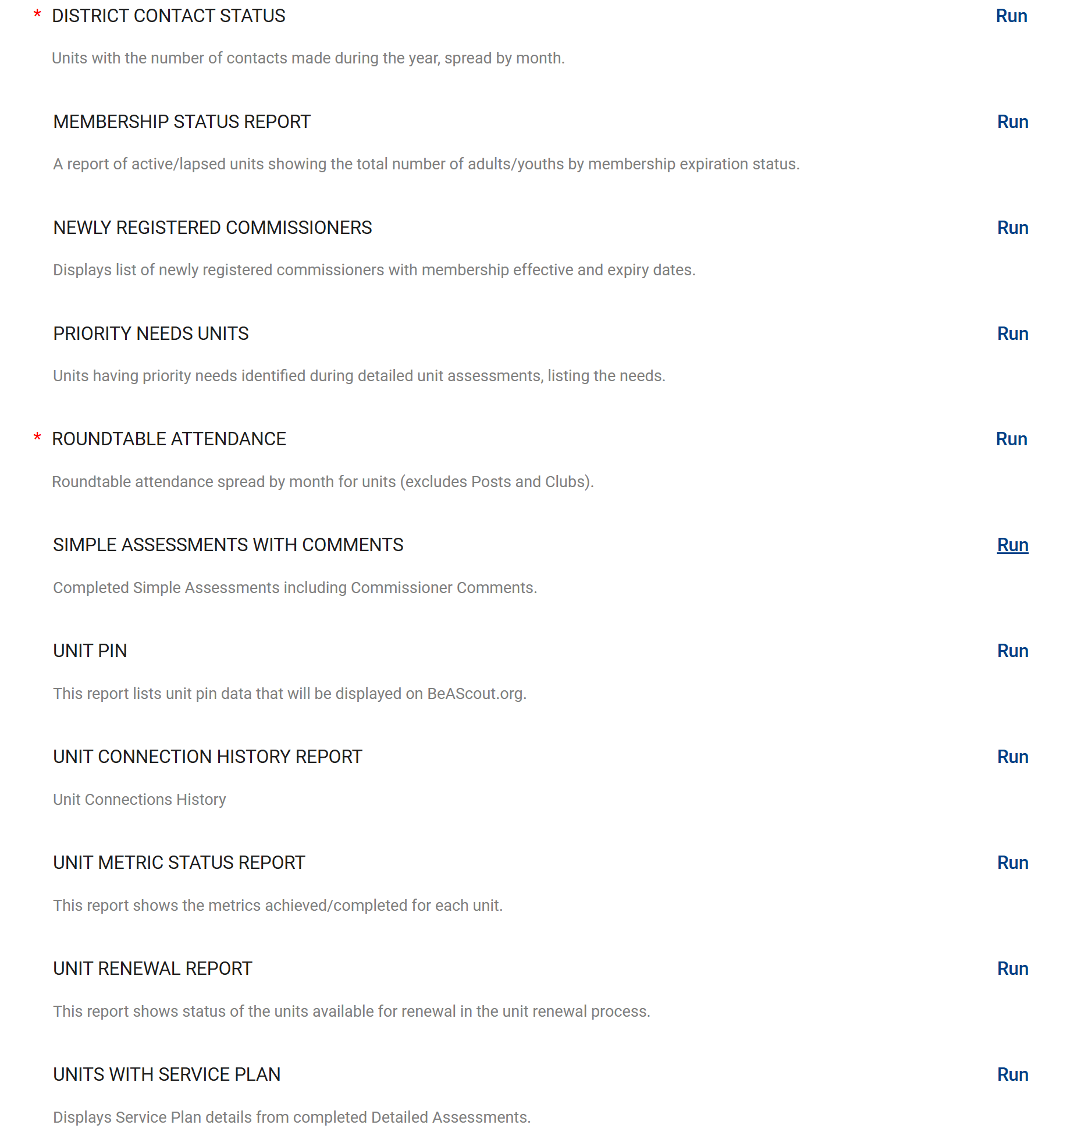
Commissioner Tools Reports
SIMPLE ASSESSMENTS WITH COMMENTS provides summary view of all YTD connection comments
Are Commissioners providing unit service?
Focus here:
Do comments provide actionable information?
“Discussed Trained adult leaders with Key 3 present; SM has been unable to find IOLS course. Contacted District Training Chair and provided upcoming IOLS dates”
versus
“Attended unit meeting”
“Went to Pack Blue and Gold banquet, menu was fried chicken, mashed potatoes, green beans and peach cobbler; food was great!”
Are comments related to Connections topic?
Notes:
Commissioner Tools Reports
These are key Commissioner Tools reports that you can use to monitor unit service in your council:
Unit Connection History report shows the Unit Connections History for each unit.
Unit Metric Status Report shows the metrics achieved/completed for each unit.
District Contact Status report provides information on units with the number of connections made during the year, spread by month.
Priority Needs Units is a tool that identifies units within the district that require support. These units need help now. In a district that might have limited commissioner resources, you can use the information in this report to assign commissioners to the units with the greatest need for assistance.
Roundtable Attendance report shows roundtable attendance spread by month for units (excludes Posts and Clubs).
An assistant council commissioner can generate this information for you monthly so that you can keep district commissioners accountable for unit service in their districts.

Slide 26
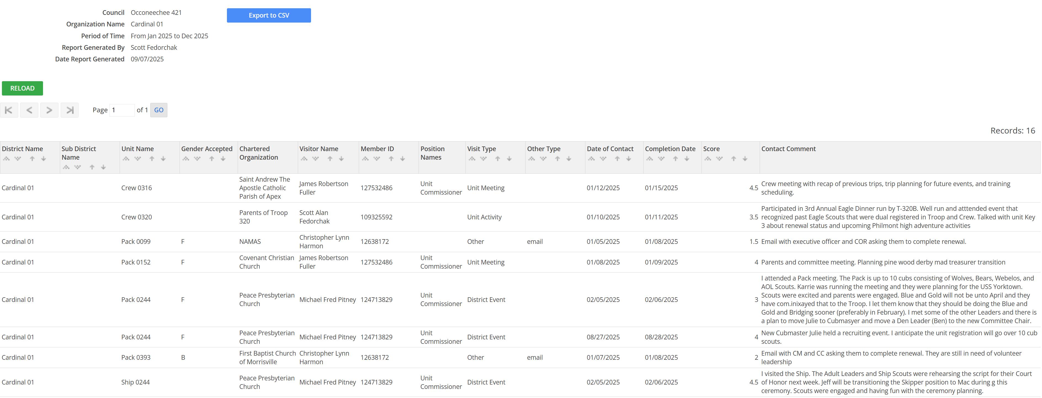
Commissioner Tools Reports
Notes:
Commissioner Tools Reports
These are key Commissioner Tools reports that you can use to monitor unit service in your council:
Unit Connection History report shows the Unit Connections History for each unit.
Unit Metric Status Report shows the metrics achieved/completed for each unit.
District Contact Status report provides information on units with the number of connections made during the year, spread by month.
Priority Needs Units is a tool that identifies units within the district that require support. These units need help now. In a district that might have limited commissioner resources, you can use the information in this report to assign commissioners to the units with the greatest need for assistance.
Roundtable Attendance report shows roundtable attendance spread by month for units (excludes Posts and Clubs).
An assistant council commissioner can generate this information for you monthly so that you can keep district commissioners accountable for unit service in their districts.

Slide 27
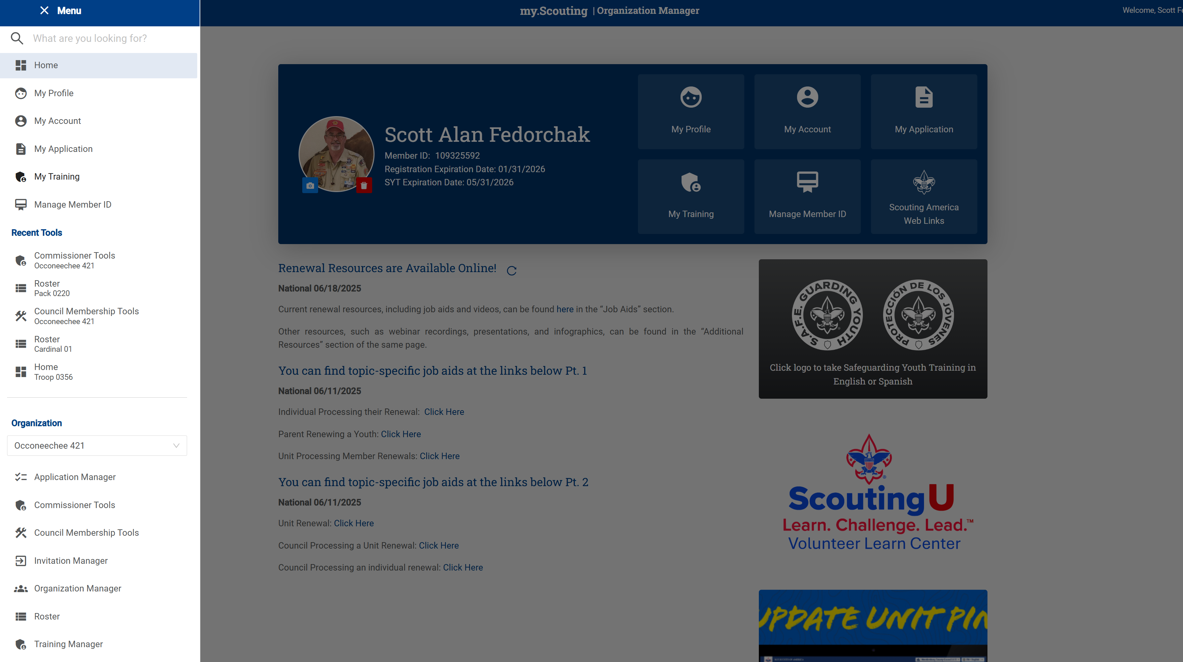
Additional Administrative Commissioner Reports
Additional useful reports for Activities, Advancement, Membership and Unit Renewal are available in Organization Manager and Roster in My.Scouting.org
They are accessed through the My.Scouting.org home page using the dropdown menu

Slide 28
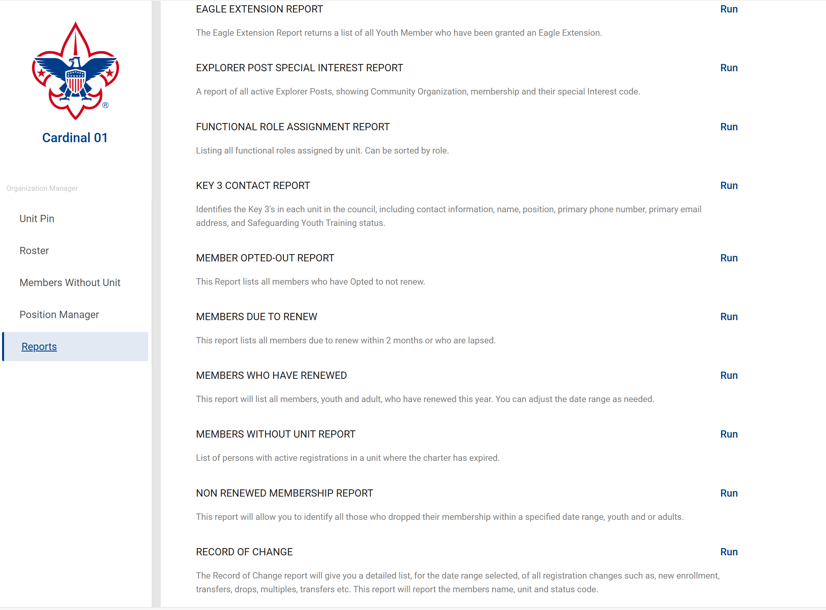
Roster and Organization Manager Reports
Available report menus are the same in both Roster and Organization Manager
Most useful Commissioner reports are:
Members opted out
Members choosing to not renew
Why did they not renew?
Members due to renew
Members entering 60-day renewal window
Is current email correct?
Non-renewed Membership report
Members failed to renew in renewal window
Members will continue to show for 60 days
In Aug 23, Scouting America changed to annual individual membership renewal
With traditional Fall recruiting, significant percentage of members in the September report period are new to Scouting
In Aug 24, we found a significant number of parents did not know that membership had to be renewed each year
“Save a Scout” campaign
Notes:
Commissioner Tools Reports
These are key Commissioner Tools reports that you can use to monitor unit service in your council:
Unit Connection History report shows the Unit Connections History for each unit.
Unit Metric Status Report shows the metrics achieved/completed for each unit.
District Contact Status report provides information on units with the number of connections made during the year, spread by month.
Priority Needs Units is a tool that identifies units within the district that require support. These units need help now. In a district that might have limited commissioner resources, you can use the information in this report to assign commissioners to the units with the greatest need for assistance.
Roundtable Attendance report shows roundtable attendance spread by month for units (excludes Posts and Clubs).
An assistant council commissioner can generate this information for you monthly so that you can keep district commissioners accountable for unit service in their districts.

Slide 29

Questions
Contact Ed Reynolds
Assistant Council Commissioner
ed.reynolds.cctx@gmail.com
Notes:
This version of commissioner tools puts unit information on a dashboard so that the information a commissioner needs to support units is in one easily accessible location.

Slide 30

Philmont Commissioner Week
Come join us at the
Philmont Training Center’s Commissioner Week
7 - 13 June 2026
Philmont Training Center Conferences - Philmont Scout Ranch

